Slide 1
User Authentication & Identity Management

Slide 2











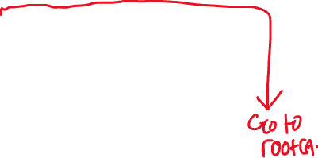


Recap of Week 5
A public key certificate serves as the token that vouches for the ownership of a public key. It is signed by CA upon the certificate body.
Key elements in certificates.
Certificate request and issuance
Certificate verification
Certificate revocation
Symmetric key distribution (with public key certs)

Slide 3
Overview
Content
  Concept of user authentication
  Two types of user authentication schemes
    Weak authentication: Password based
    Strong authentication: shared key based
  Identity management for Web Services – Open ID
After this module, you should be able to
  Describe how users are authenticated by computers and service providers
  Describe the risks of weak passwords and how to protect them
  Describe the key differences between weak authentication and strong authentication
  Describe how user authentication is managed efficiently using Open ID

Slide 4
Concept of User authentication

Slide 5






Who Are You?
Impersonation in cyber-world.
How does Bob prove himself to a server?
Bob
This is Bob
Mallory
This is Bob!

Slide 6
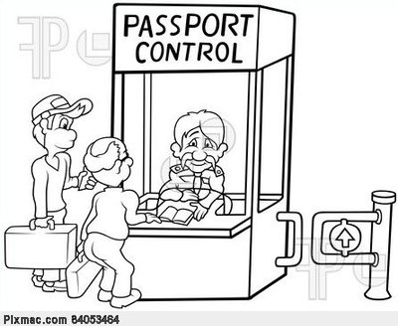
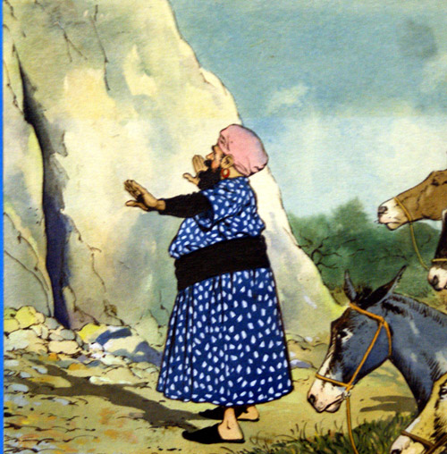



User Authentication in Real Life
What you have
What you know
What you are
Passport control
“Open Sesame”
pin to lockers
Your face
Is it the same as certificate verification?

Slide 7
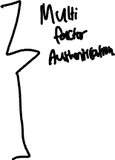
User Authentication in Cyberspace
What Bob knows
  Passwords, PIN, mother’s maiden name
What Bob possesses
  Physical key, token, smart card, passport
What Bob is (biometrics)
  Fingerprints, retina, voice, face, signature dynamics
I’m Bob. I know our secret S
(Bob, S)
S
Bob
Notes:
Know, Have, Is

Slide 8

Weak and Strong Authentication
User authentication based on a shared secret.
  Weak authentication: Bob proves his identity to the server by revealing knowledge of S.
  Strong authentication: Bob does not reveal S but proves knowledge of it.
I’m Bob. I know our secret S
(Bob, S)
S
Bob

Slide 9
Two types of user authentication schemes
Weak authentication: Password based

Slide 10



Why Password?
The most popular user authentication technique
  Low cost, user-friendly, easy to implement.
  Is it secure or not (based on your experience)?
I’m Bob, and my password is X
Server
Bob
Password file
…
X
Password authentication design
Assumption: the communication channel is confidential!
Challenge: If the server is compromised, user passwords would be revealed.

Slide 11

Password File Stored in Server
Server maintains a password file which contains information regarding each user account and the corresponding password.
User ID | Password
alice | ?????
bob
charlie
dave
...
Questions:
Should passwords be stored in plaintext?
Should passwords be stored in ciphertext?

Slide 12
Weak Authentication
Non-cryptographic technique
  Server: stores “Bob id – Bob password” in a password file
  Bob: sends his id and password to the server
  Server: authenticates Bob by comparing his password to the password file entry corresponding to Bob’s id
Password file
(Bob, password)
Bob, password
Bob
Server

Slide 13


Weak Authentication
“Encrypted” password file
  Bob sends an “encrypted” password to Server
  Server compares two pieces of ciphertext
Password file
(Bob, E(password))
Bob, E(password)
Bob
Server

Slide 14


Weak Authentication
“Encrypted” password file
  Server: stores the encryption of Bob’s password
  Bob: sends his id and password to Server
  Server: authenticates Bob by decrypting the corresponding entry in the password file and comparing it against the received password
Server needs to protect the decryption key
Password file
(Bob, E(password))
Bob, password
Bob
Server

Slide 15





Password File Stored in Server (A better approach)
  Initialization: Server chooses an arbitrary message M (e.g. M is a string of 128 0-bits.) and creates a password file.
  To register a user, Server inserts a new record to the password file. The record consists of two items:
    User id;
    A ciphertext obtained by encrypting M using the user's password;
  Server’s verification procedure:
    encrypt M using the submitted password to get a ciphertext
    compare the result against the corresponding record in the password file.
  Advantage: Server does not store any secret! Server does not keep the users’ passwords!
Notes:
Only a cipher reference.

Slide 16





Weak Authentication
Password file
( Bob, E_{password}(M) )
Bob, password
Bob
Server
  In practice, we can achieve the same effect by using a hash function, i.e., storing H(password) on the server side, instead of using encryption.

Slide 17







Attack on passwords
Based on whether to involve the authentication Sever
  On-line attack: Server is involved during attacks.
  Off-line attack: Server is not involved during attacks
Based on how to guess
  Brute-force attack: guess randomly
  Dictionary attack: guess from a dictionary

Slide 18



Online/Offline Attacks
On-line attack can be easily countered by
  Choosing long password
  Limiting the number of tries
  Slowing down log-in process
Off-line attack
  Adversary (with the help of some automated tool)
    Obtains the password file
    Tries every possible password and encrypt/hash it
    Compares the ciphertext/hash result of each tried password to all entries in the password file
  Does not involve the authentication server.

Slide 19
Password Search Space
If passwords are randomly chosen.
  Suppose all passwords are 8 characters long, including capital cases
  Number of possible passwords: 52^8 ≈5.3×10¹³
  One year has around 3×10⁷ seconds.
  If Mallory can try 10^6 passwords/sec ➔ 1.8 years
In reality, they are not randomly selected!
    Same as user ID
    Derived from user’s name, birthday, phone number, etc.
    Common word list or patterns (e.g. qwerty, aaaa, abc123, asdfg, password, 123456)
    Can be guessed via social engineering

Slide 20
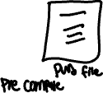





Dictionary Attack
In practice, user passwords are not selected randomly.
Adversary (with the help of some automatic tool)
  Creates a dictionary of commonly used passwords (probably including all the words in a common dictionary)
  Pre-computes password file of the dictionary
  Looks for a match between the pre-computed password file and the real password file
Dictionary attacks are fast, but only work for weak passwords
Notes:
Assumes that hashing is used. So a list of possible passwords list is built and then steal the real password file. Both can be used to compare with each other to find the real values. Weak passwords, this one will be very fast.

Slide 21
How to Choose High-Quality Password
Using pass-phrase
  Easy to remember
  Appears random
Examples
  “I'll make him an offer he can't refuse.”
  Password: mhaohCr23

Slide 22


Drawbacks of Weak Authentication
The user has to reveal her secret. It implies that the user and server MUST use an encrypted channel, i.e. the communications are encrypted.
Password authentication is subject to replay attacks
  the user always submits the same information (i.e. username+password)
  Replay Attack: The attacker can re-send whatever the user has sent in prior authentication sessions, without knowing the actual data.
Notes:
User must REVEAL the password. Everything is password based.
The replay attack is basically like phising, using someone’s identity as atacker will know your info already and just do whatever he wants.

Slide 23
Two types of user authentication schemes
Strong authentication: shared key based

Slide 24
Strong Authentication
Strong Authentication: the user does not reveal her secret to the server.
Objectives:
  to defeat replay attacks.
  to remove the need for an encrypted channel.
  It also mitigates brute-force and dictionary attacks because the user uses a cryptographic key instead of a password.
Applications: smart-card based authentication
Two methods for strong authentication:
  challenge-response protocol
  time-stamp protocol

Slide 25






Challenge-Response protocol
Server and Bob share a secret key K
Upon authentication request, Server sends Bob a random challenge C.
  (Protocol is not secure if C is not random).
Bob responds with R_{b}=Enc_{K}(C) or R_{b}=Hash(K||C)
Server computes R_{s} in the same ways as Bob does. If R_{s}=R_{b}, Bob is authenticated successfully.
Bob
Server
attacker
Bob id
K
C
K
R_{b}=Enc_{K}(C)
Notes:
Can fight the attack on replay attack as a HASH is sent with the secret now, every auth session will change.

Slide 26




Time Stamp Authentication Protocol
Server and Bob keep synchronized clocks and a shared key K
  Time is used as one-time “challenge”
Bob sends Server his id, and R=Enc_{K}(T) or Hash(K||T) with his clock reading T.
Server verifies whether R=Enc_{K}(T) or Hash(K||T) using Bob’s key K and its own clock reading
Bob id, R=Enc_{K}(T)
K
Bob
K
Server

Slide 27



Time Stamp Authentication Protocol
The validity of the response R=Enc_{K}(T) or Hash(K||T) is checked against a pre-defined time window (e.g., 30 seconds)
  T: Bob’s clock reading when R is generated
  T’: the server’s clock reading when R is received
  If R=Enc_{K}(T): The server decrypts R and compares (T’-T) < window size
  If R= Hash(K||T): The server computes hashes for all the possible times within
  [T’ – window_size, T’], and accepts iff R matches one of them

Slide 28
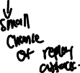
Comparisons
Challenge-response
  3 message flows
  Needs to generate a random number B
Time stamp
  1 message flow
  time synchronization is difficult.
  a time window for attacks
    because a response is valid within a time window, the eavesdropper can re-use the response within that time window.

Slide 29
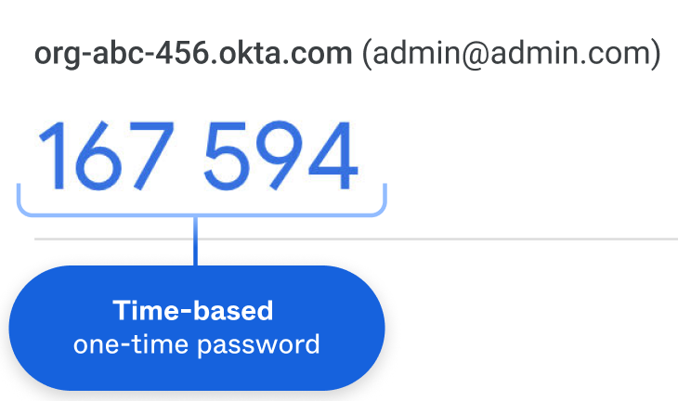
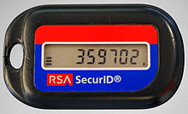
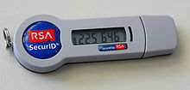
Hardware/Software Based Implementations
Hand-held devices
  with CPU, I/O and memory
  Symmetric, asymmetric key algorithms can be implemented
  Examples: RSA SecurID
Software based alternatives

Slide 30
Two Factor Authentication
Possible implementations of 2FA
    PIN +
    Hardware token, or software security code generator on mobile phones
Possible use scenarios
    ID first, then PIN and OTP together
    ID & PIN first, then OTP are sent for authentication
    1FA first, then ask for 2FA for every sensitive transaction
In Nov 2005, MAS mandated the deployment of 2FA by Dec 2006

Slide 31
Identity Management

Slide 32


The Challenge of User Authentication
Not all the services used by Bob are managed by the same party
Does Bob need to create an account for each service?
Telegram
Zoom
Bob
Google Drive
Agoda
Tripvisor

Slide 33
Authentication in the Web
Authentication to a single server is ‘easy’: there is a choice of reasonably secure authentication protocols.
Authentication to lots of servers is ‘difficult’
  A separate user account on each server?
  A separate password for each server?
Solution: Authenticate to a dedicated authentication server
  Authentication server issues credentials that can be presented as ‘proof of authentication’
Telegram
Zoom
Bob
Google
Amazon
Tripvisor

Slide 34


Open ID for Web Services
source web site
asserting party – aka identity provider
1. authenticate
Pre-existing trust relationship
destination web site
relying party – aka service provider
Web user
2. access resource

Slide 35
Asserting Party
Asserting party: system or administrative domain that asserts information about a subject
Asserts that a user has been authenticated and has been given associated attributes
    E.g. This user is John Smith, has the email address john.smith@acompany.com, was authenticated into this system using a password mechanism

Slide 36
Relying Party
Relying Party: system or administrative domain that relies on information supplied to it by the asserting party
It is up to the relying party as to whether it trusts the assertions provided to it
    Trust: assertion really comes from the asserting party
    Local access policy defines whether a subject may access local resources
There is a pre-established trust between relying parties and asserting parties.
Notes:
SAML defines a number of mechanisms that enable the relying party to trust the assertions provided to it

Slide 37


How it works
User is authenticated by the asserting party; wants to access a resource from relying party
Asserting party sends an artifact to client via HTTP redirect
  Artifact: base-64 encoded string consisting of a unique identity of the source site (Source ID) and a unique reference to the assertion (AssertionHandle)
Client passes artifact as a HTTP query variable in HTTP message to destination site (relying party)
Relying party sends a request with the artifact to the asserting party
Assertions about the user are transferred back in response.
The communications between the asserting party and the relying party use the Security Assertion Markup Language (SAML)
relying party
www.xyz.com
asserting party
www.abc.com
assertion
artifact
request
redirect
browser
E.g. artifact: AAQAAMh48/1oXIM+sDo7Dh2qMp1HM4IF5DaRNmDj6RdUmllwn9jJHyEgIi8=

Slide 38
Take Away
Weak authentication
  reveals secret over the channel
  subject to replay attack
Strong authentication
  Secret is not revealed but user shows that he knows the secret
  Challenge-response or Timestamp is used to defend against replay attack
Password Attacks
  Online vs Offline attack
  Brute-forcing and Dictionary attack
Identity Management & Open ID
  Based on a dedicated authentication server
  User only needs to log in to the authentication server (asserting party)
  Needs to establish trust relationship between asserting party and relying parties

